Slide 1

<PENTER’S PUBLISHING>
Apoorva Jain
17.09.2017
Case #1
Prepared for
EMIS 7360

Slide 2
Penter publishing have less competent staff and IT structure to reach upto the height of NORTH STAR.
Background
Overview of Business
By 2010 Penter publishing was a $300 MM company.
The company have the rights to the work and can publish them.
Headquarter of the company is in Carbondale, Illinois.
It was founded back by Jack Penter in 1972.
Present CEO of the company is Garry III .
The company is of 250 employee.
On average its been 20 years for the author to be with the Penter’s.
They company almost distributes 3500 books across UK, US and Canada.
The company deals with the customers to identify which books should be on shelves.
They almost distributes their catalog via email to approx. 25000 email addresses.
They fulfill their orders almost by direct shipment that concludes to approximately 5% of the revenue.
They haven’t used the internet and they are concerned about current retails methods.
Northstar company is the biggest competitor for the company, which have 1100 employ and has a revenue of $2.5B.

Slide 3
Background
Overview of IT
Tom Wallace is the IT Director, who reports to the CFO of the company.
They set the priorities in harmonic with CFO and senior management employee.
There are 11 people working in IT, that includes 4 infrastructure staff, 2 system operators, 1 assistant to the director and 4 people for development.
Salary for staff is $680k.
Maintenance of hardware is $72k and software is $55k.
Spending on IT supplies: $32k.
Spending on Telecom: $68k.
Miscellaneous expenditure is $18k.
They work on Unix system which were purchased years ago.
The company have systems that have operating systems such as Windows Vista, Windows 7, Windows 2000 etc.

Slide 4
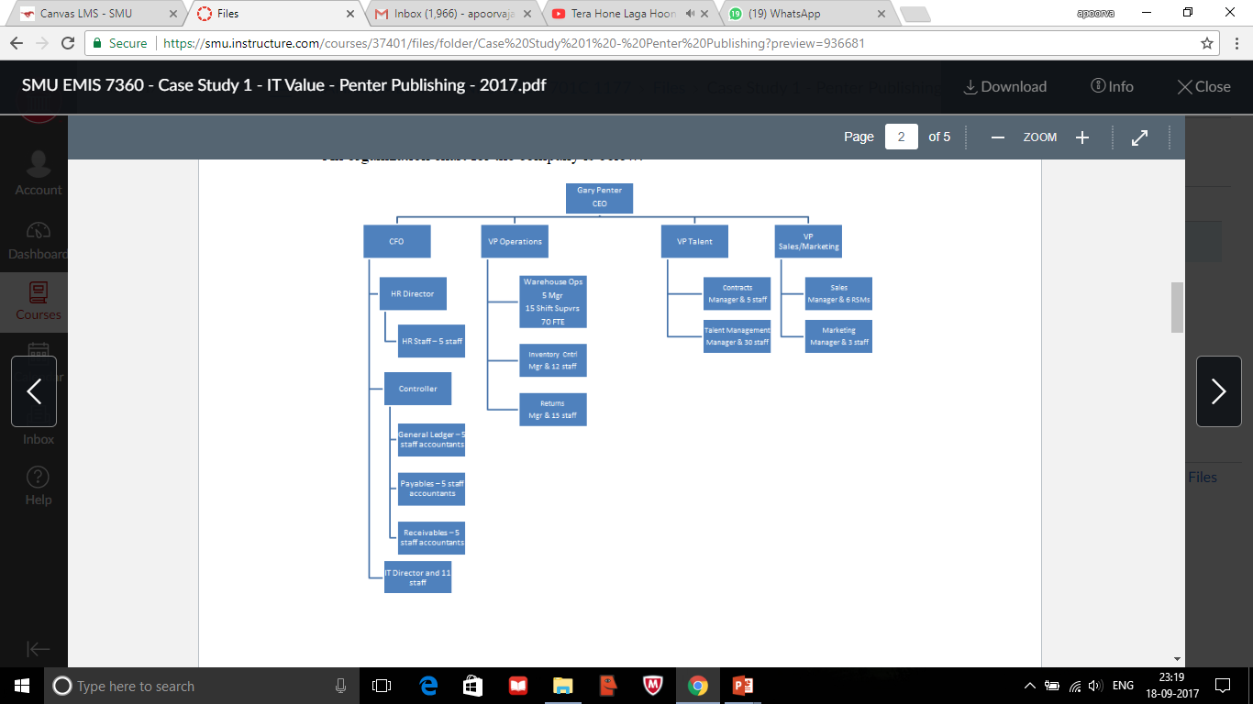
IT DEPARTMENT SHOULD WORK HARD ON THE FUTURE ASPECTS, CFO WHERE ARE YOU ?
Findings
The average profit margin is $30MM.
  Its stated that the company has a business of $300MM.
They don’t use internet to distribute there catalog orders.
  Penter’s didn’t explored the internet part for direct shipment.
  There main concern is about ongoing retail partnership.
There authors are affiliated to the company for more than 20 years.
  Its been stated that on average the affiliation of author is for 20 years.
The IT director should be more competent in the IT field.
  The director is the CEO’s friend and has an experience in business and associate degree in computing technology.
11 staffs listed for IT department.
  As shown below in the figure.

Slide 5
Annual budget of IT should be approx. $960K/annual.
  Annually an average spending on IT is 3.2-3.5% of the revenue.
Applications mostly run on systems which were purchased years ago.
  Its stated that the applications runs on Java and old systems as stated.
Turnover rate is low
  The HR Director said that they have a low turnover rate but created a world class structure.
They work hard to keep the systems running.
  IT Director said that it gets lot of efforts to make the systems running while uptime.
North star is great rival to Penter’s publishing company.
  There revenue is $2.5B.
  1100 employee.
  The CEO of Penter’s wants to up high like North star as he stated.

Slide 6
HURRY! STAFF NEEDED , UPDATE THE SYSTEMS AND GO HAND IN HAND WITH TECHNOLOGY.
Recommendation
They should start expanding and direct ship by exploring the internet side.
  As they have not explored the internet side yet
They should bring new authors to work with them so that they can get new interesting stuff to attract the customers.
  Its been stated that on average the affiliation of author is for 20 years.
They should appoint a director with more experience in managing the IT department , has a knowledge about IT and studied from a renowned college.
  CEO favors nepotism as the IT director is his friend.
IT needs more staff to work with.
  They just have 11 staffs.
  Atleast 5 in operations department ,10 in infrastructure and 10 in development team.
They should spend more on IT atleast 3.2% of revenue
  They spend $925 which is less then 3.2% of the revenue.
They should update all the systems and go hand in hand with the technology.
-They work on Unix system which were purchased years ago.
-The company have systems that have operating systems such as Windows Vista, Windows 7, Windows 2000 etc.

Slide 7
Working notes
1 – 10% IS generally profit that is equal to $30MM.
2 – 3.2% is minimum IT budget of revenue that is $960k
3 – The system are old that’s why the need lot of effort's to work on with the systems
4 - Managing is not easy with less staff..
Working Notes

